Slide 1
Instance-based Learning

Slide 2
Outline
Introduction of Instance-based learning
K-Nearest Neighbor
Case based Reasoning
Reference

Slide 3
Instance-based Learning - Overview
In contrast to learning methods that construct a general, explicit description of the target function when training examples are provided, instance-based learning methods simply store the training examples.
Generalizing beyond these examples is postponed until a new instance must be classified.
Each time a new query instance is encountered, its relationship to the previously stored examples is examined in order to assign a target function value for the new instance.

Slide 4
Instance-based Learning - Overview
Instance-based learning methods are sometimes referred to as delayed/lazy learning methods because they delay processing until a new instance must be classified.
A key advantage of delayed/lazy learning is that instead of estimating the target function one for the entire instance space, these methods can estimate it locally and differently for each new instance to be classified.

Slide 5
Instance-based Learning - Overview
Instance-based learning methods such as Nearest Neighbor are conceptually straightforward approaches to approximating real-valued or discrete-valued target functions.
  Learning in these algorithms consists of simply storing the presented training data.
  When a new query instance is encountered, a set of similar related instances is retrieved from memory and used to classify the new query instance.

Slide 6
Instance-based Learning - Overview
Many techniques construct only a local approximation to the target function that applies in the neighborhood of the new query instance, and never construct an approximation designed to perform well over the entire instance space.
This has significant advantages when the target function is very complex, but can still be described by a collection of less complex local approximations.

Slide 7
Instance-based Learning - Disadvantages
One disadvantage of instance-based approaches is that the cost of classifying new instances can be high.
  This is due to the fact that nearly all computation takes place at classification time rather than when the training examples are first encountered.

Slide 8
Instance-based Learning - Disadvantages
A second disadvantage to many instance-based approaches, especially nearest neighbor approaches, is that they typically consider all attributes of the instances when attempting to retrieve similar training examples from memory.
  If the target concept depends on only a few of the many available attributes, then the instances that are truly most "similar" may well be a large distance apart.

Slide 9
K-nearest Neighbor Learning
(Intro.)
The most basic instance-based method is the k-NEAREST NEIGHBOR algorithm.
This algorithm assumes all instances correspond to points in the n-dimensional space ℜ^{n}. That means inputs of data are numeric ones.
The nearest neighbors of an instance are defined in terms of the standard Euclidean distance.

Slide 10
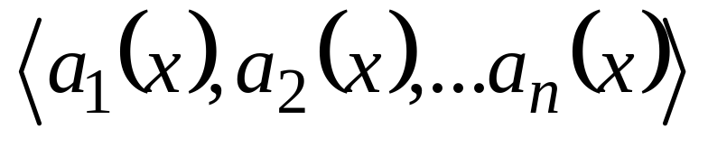
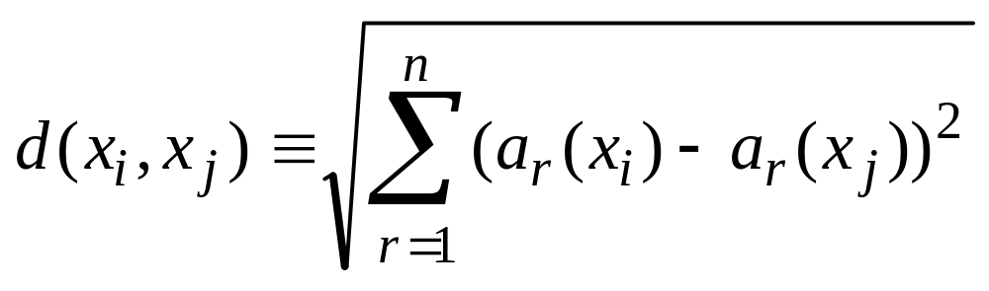
K-nearest Neighbor Learning
(Euclidean distance)
Let an arbitrary instance x be described by the feature vector
where a_{r}( x ) denotes the value of the r^{th} attribute of instance x . Then the distance between two instances x_{i} and x_{j} is defined to be d( x_{i} , x_{j} ) , where

Slide 11
K-nearest Neighbor Learning
(output type)
In nearest-neighbor learning the target function may be either discrete-valued or real-valued.
Let us first consider learning discrete-valued target functions of the form f : ℜ^{n} -> V, where V is the finite set {v_{l}, . . . v_{s}}.
The k-NEAREST NEIGHBOR algorithm for approximating a discrete-valued target function is given in next page ->

Slide 12
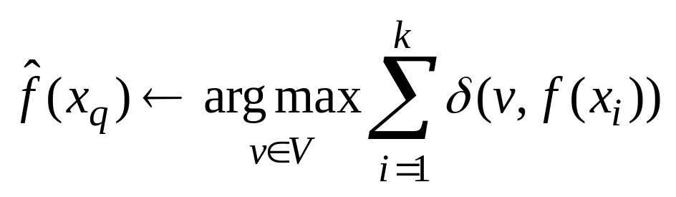
K-nearest Neighbor Algorithm for approximating a discrete-valued function f : ℜ^{n} -> V,
Training algorithm:
  For each training example <x, f(x)>, add the example to the listing training_examples
Classification algorithm
  Given a query instance x_{q} to be classified,
  Let x₁….x_{k} denote the k instances from training_examples that are nearest to x_{q}
  Return
Where δ(a, b) = 1 if a = b and 0 otherwise.

Slide 13

K-nearest Neighbor Algorithm for approximating a discrete-valued function f : ℜ^{n} -> V,
As shown there, the value returned by this algorithm as its estimate of f(x_{q}) is just the most common value of f among the k training examples nearest to x_{q}.
If we choose k = 1, then the 1-NEAREST NEIGHBOR algorithm assigns to the value f(x_{i}) where x_{i} is the training instance nearest to x_{q}.
For larger values of k, the algorithm assigns the most common value among the k nearest training examples.

Slide 14
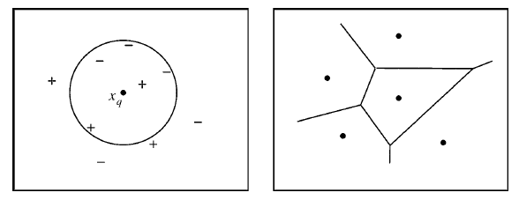
K-nearest Neighbor Algorithm for approximating a discrete-valued function f : ℜ^{n} -> V,
1 Nearest Neighbor classifies x_{q} positive, 5 Nearest Neighbor classifies x_{q} as negative. The diagram on the right hand side shows the decision surface induced by 1-Nearest Neighbor.

Slide 15
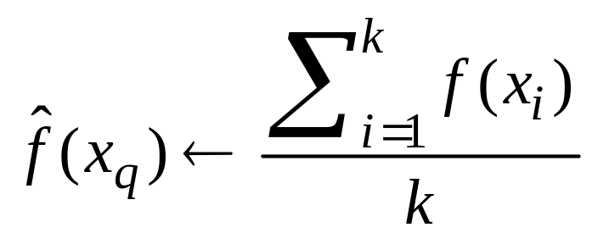
K-nearest Neighbor Algorithm for approximating a continuous-valued function f : ℜ^{n} -> V,
Calculate the mean value of the k nearest training examples.
Replace the final line of previous algorithm by:

Slide 16
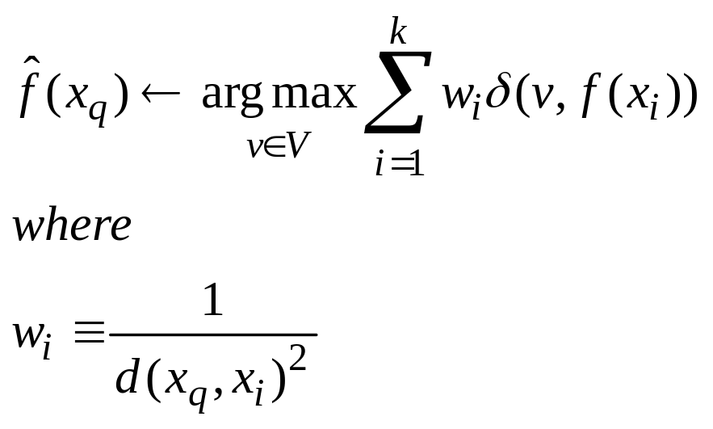
Distance-Weighted Nearest Neighbor Algorithm for discrete-valued target functions
Weight the contribution of each of the k neighbors according to their distance to the query point x_{q}, giving greater weight to closer neighbors.
If x_{q} exactly match one of the training instances x_{i}, the denominator d(x_{q},x_{i})² is zero and, we assign to be f(x_{i}).

Slide 17
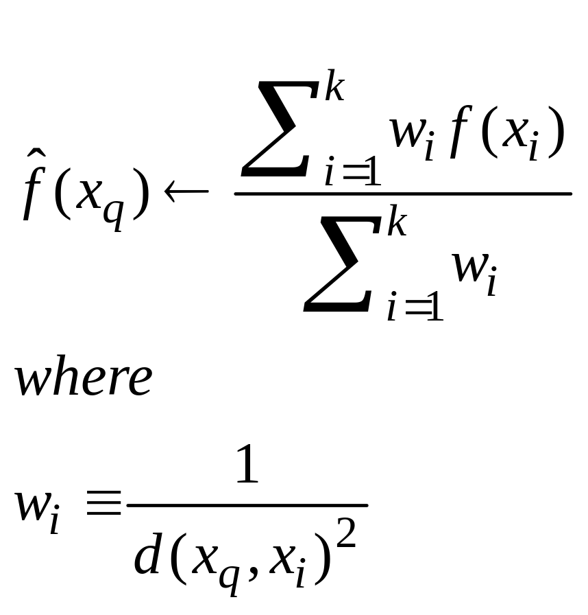
Distance-Weighted Nearest Neighbor Algorithm for continuous-valued target functions
We can distance-weight the instances for real-valued target functions in a similar way.

Slide 18
Remark
Note all of the above variants of the k-NEAREST NEIGHBOR algorithm consider only the k nearest neighbors to classify the query point.
Once we add distance weighting, there is no harm in allowing all training examples because very distant examples will have very little effect on
The only disadvantage of considering all examples is that our classifier will run more slowly.
If all training examples are considered when classifying a new query instance, we call the algorithm a global method.
If only the nearest training examples are considered, we call it a local method.

Slide 19
Remark
The distance-weighted k-NEAREST NEIGHBOR algorithm is a highly effective inductive inference method for many practical problems.
It is robust to noisy training data and quite effective when it is provided a sufficiently large set of training data.
Note that by taking the weighted average of the k neighbors nearest to the query point, it can smooth out the impact of isolated noisy training examples.

Slide 20
Remark
Since the algorithm delays all processing until a new query is received, significant computation can be required to process each new query.
Various methods have been developed for indexing the stored training examples so that the nearest neighbors can be identified more efficiently at some additional cost in memory.
One such indexing method is the kd-tree
http://www.autonlab.org/autonweb/14665/version/2/part/5/data/moore-tutorial.pdf?branch=main&language=en

Slide 21
Case-based Reasoning

Slide 22
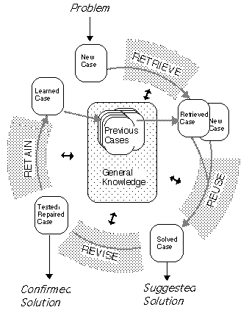
RETRIEVE the most similar case(s);
REUSE the case(s) to attempt to solve the problem;
REVISE the proposed solution if necessary, and
RETAIN the new solution as a part of a new case.

Slide 23
CBR cycle
This cycle currently rarely occurs without human intervention.
Case revision (i.e., adaptation) often being undertaken by managers of the case base.
However, it should not be viewed as weakness of CBR that it encourages human collaboration in decision support.

Slide 24
Case Representation
Typically a case comprises:
  the problem that describes the state of the world when the case occurred,
  the solution which states the derived solution to that problem.

Slide 25
Indexing
Case indexing involves assigning indices to cases to facilitate their retrieval.
Indexing cases by features and dimensions that tend to be predictive across the entire domain.

Slide 26
Storage
The case-base should be organized into a manageable structure that supports efficient search and retrieval methods.
A balance has to be found between storing methods that preserve the semantic richness of cases and their indices and methods that simplify the access and retrieval of relevant cases.
These storage methods are usually referred to as case memory models.

Slide 27
Retrieval
Retrieval of cases from the case-base must be equipped with heuristics that perform partial matches, since in general there is no existing case that exactly matches the new case.
Retrieval methods include: nearest neighbor, knowledge guided induction and template retrieval.

Slide 28
Retrieval - Nearest neighbour
Assess similarity between stored cases and the new input case, based on matching a weighted sum of features.
The biggest problem -> to determine the weights of the features.
The retrieval time increasing linearly with the number of cases.
Effective when the case base is relatively small.

Slide 29

Retrieval - Nearest neighbor algorithm based on features
where w is the importance weighting of a feature (or slot), sim is the similarity function, and f^{I} and f^{R} are the values for feature i in the input and retrieved cases respectively.

Slide 30
Knowledge guided induction
This method use heuristic knowledge to find the similar cases in the case-base for the new case
For example, user may identify case features that are known or thought to affect the primary case feature.

Slide 31
Template retrieval
Similar to SQL-like queries, template retrieval returns all cases that fit within certain parameters.
This technique is often used before other techniques, such as nearest neighbour, to limit the search space to a relevant section of the case-base.

Slide 32
Adaptation
Once a matching case is retrieved a CBR system should adapt the solution stored in the retrieved case to the needs of the current case.
Looks for differences between the retrieved case and the current case and applies formulae or rules that take those differences into account when suggesting a solution.
Users usually involved in this step

Slide 33
CBR Applications
CBR could be applied to solve a problem where no explicit model existed, and
CBR systems can learn by acquiring new cases and so improve their performance with time.
http://ai-cbr.cs.auckland.ac.nz/

Slide 34
What to know more?
Instance based learning:
  http://cgm.cs.mcgill.ca/~athens/cs644/Projects/2004/SumedhaAhuja-EdithLaw/overview.html
Case-based reasoning
  http://ai-cbr.cs.auckland.ac.nz/

